Slide 1
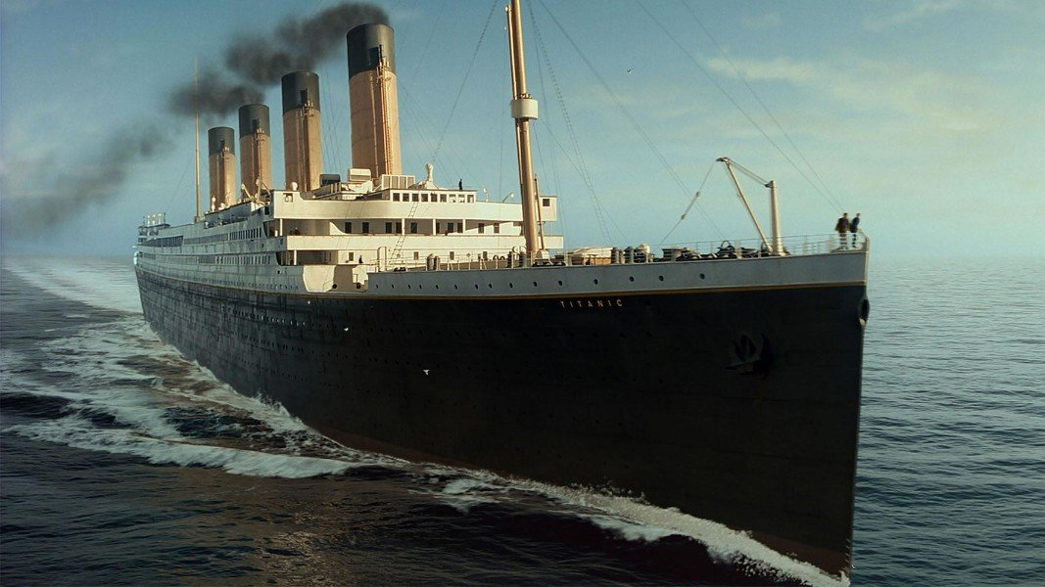
Analyzing the Unsinkable
By: Alicia Morgan, Amber Scotty, and Courtney Lewis

Slide 2
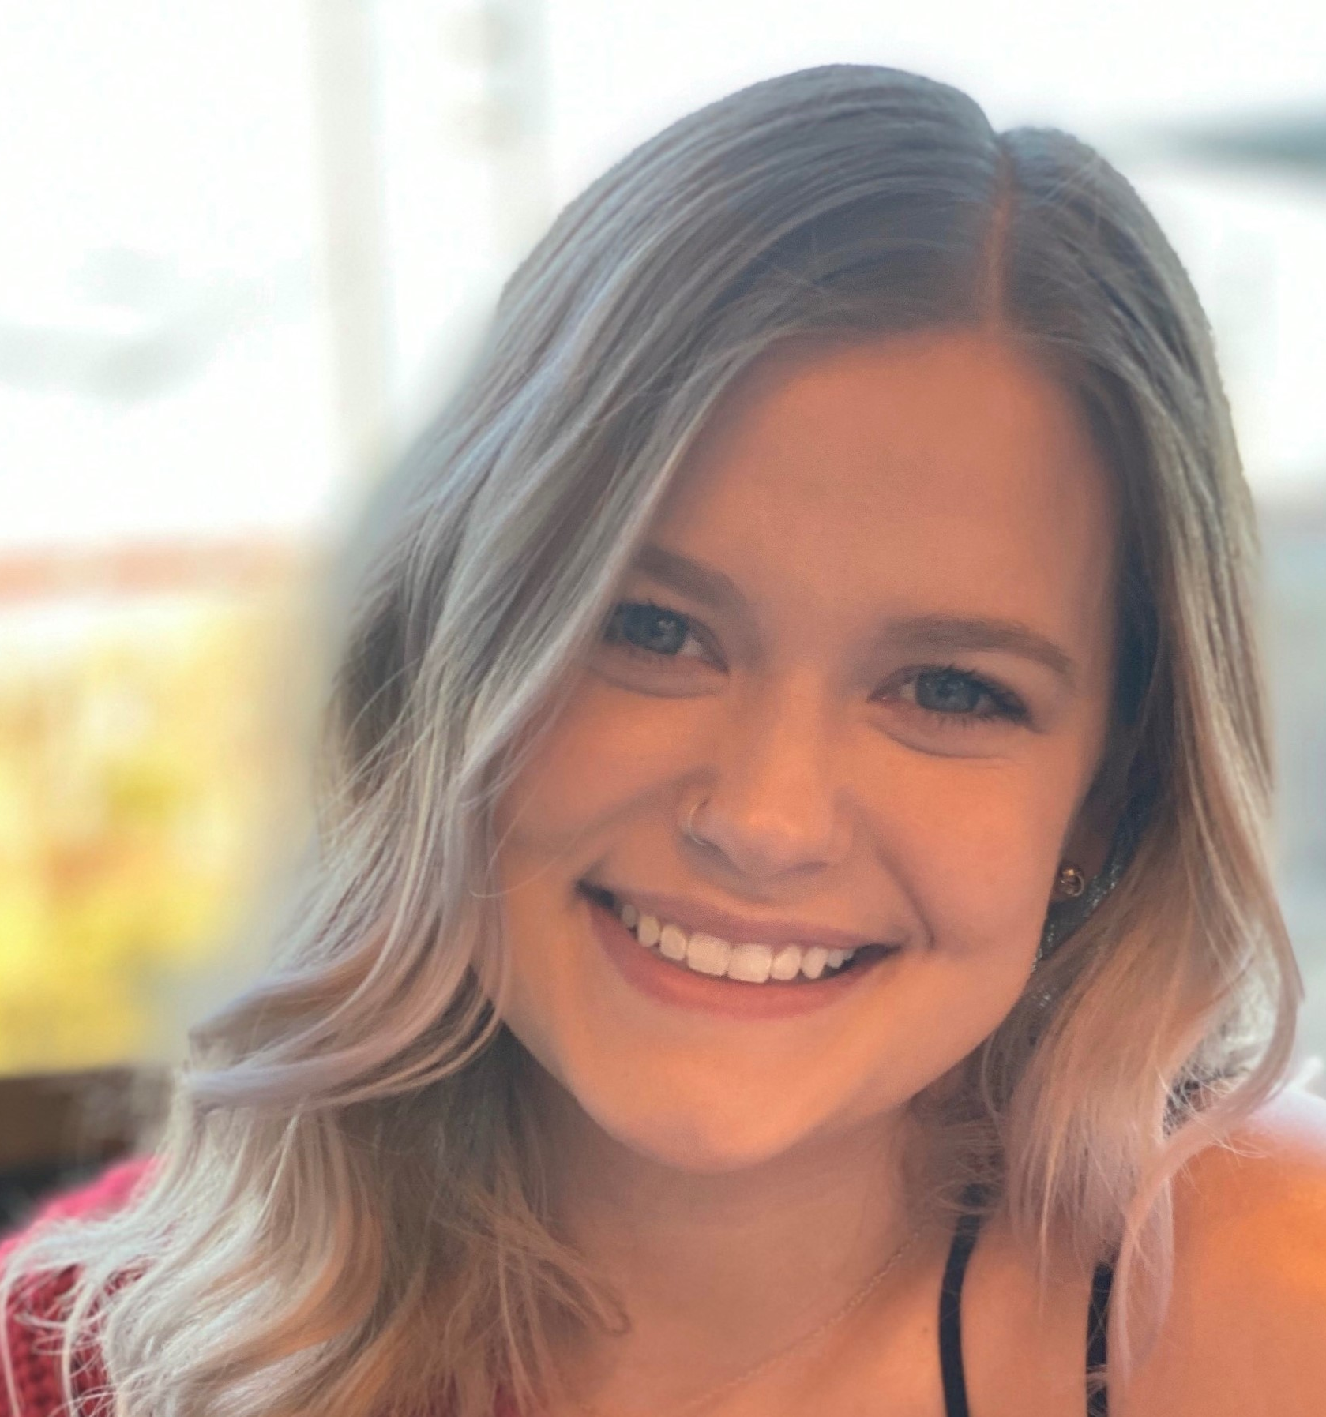
Alicia Morgan
As the daughter of an Engineer and an Accountant, my love for numbers began early! I graduated Glasgow High School in 2012 with honors and began my journey with Entity in 2021 after learning my love of coding and data at work.
For the past 5 years I have worked with Medicare, as a remote claims adjuster, which is what lead to my passion and skill of problem solving. Before claims, I worked in insurance verification and billing at my local hospital, and as a Personal Marketing Assistant where I planned events, created logos, and was responsible for all accounts payable/receivable.
I am a very determined and fast-learning individual who is looking to maintain a steady career involved in Data Science where I can continue to move up and grow with my company as my skills develop.

Slide 3
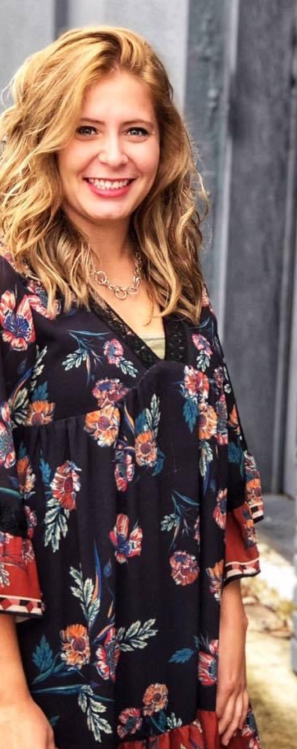
Amber Scotty
I graduated from The Ohio State University Agricultural Technical Institute (ATI) in the spring of 2012 with an Associate’s Degree in Horse Science. After graduating from ATI, I continued my academic career to The Ohio State University main campus majoring in Animal Science: Bioscience Specialization. I graduated from The Ohio State University in 2014.
Once I graduated from The Ohio State University, I landed a job working at WIL Research as a Research Biologist. This role gave me some insights of laboratory experience working with animals and how pharmaceutical medicines are created in stages during pre-clinical trials. I worked at this research facility for about a year until I was offered a job opportunity in Texas working as an Animal Control Officer.
I moved to Texas in the spring of 2015. This job was extremely rewarding yet difficult. This position allowed me to help educate the general public about proper animal welfare. I was then promoted to a Code Enforcement Officer, and I worked in this position for several years until I decided I wanted a change in life.
I decided to go back to school in June 2021. This is when I was first introduced to coding and the Data Science Course offered through Entity Academy. My journey through this course has allowed me to gain valuable critical thinking and problem-solving skills with a new love for Data Science and Coding!

Slide 4
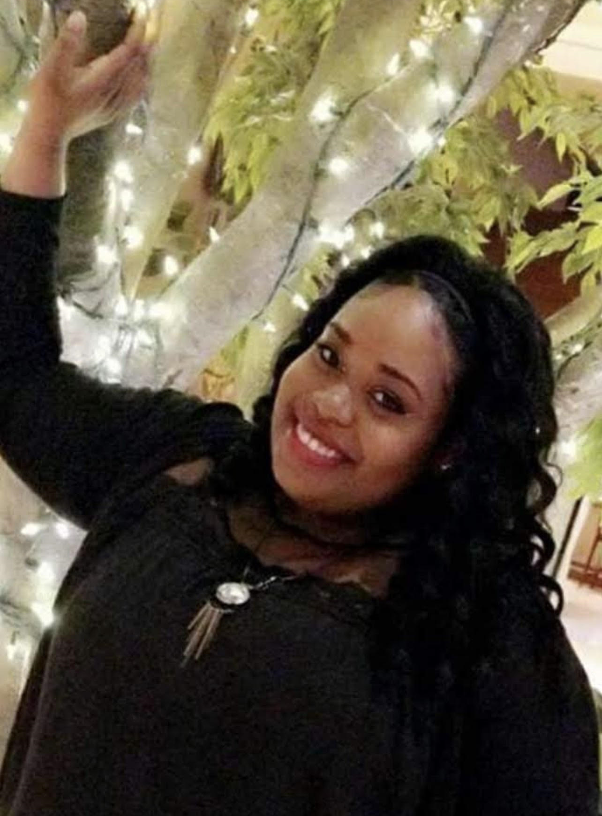
Courtney Lewis
Growing up I was always very curious and loved learning how things worked. I was an excellent student who had perfect attendance all four years of high school and graduated top 20 of my class on May 17, 2012. I always enjoyed math and analytical thinking and was always told I was very observant. Originally, I started in the field of dentistry but later changed my major to Process Technology.
I obtained my Associate degree in Applied Science and Technology at Louisiana Delta Community College on Dec 15, 2014. I had plans of becoming an engineer, but I was made an offer by Drax Biomass during my last semester at Delta. I started as a heavy equipment operator where I operated a 25-ton crane and Volvo loaders to unload logger trucks. I was later promoted to a Process Quality Lab Technician where my love for gathering data, running analysis tests and drawing conclusions emerged.
In January of 2020, I moved to Texas from Louisiana and started working at General Motors. While it was interesting and fun to assemble vehicles like: Tahoe's, Denali's, Escalades, and Suburban's I wanted a change from the industrial field.
I decided to enroll in the Data Science program through SCI. While attending the course I’ve been working remotely as a Collection Specialist at Credit Management. Now I’m looking forward to pursuing a career in the exciting field of data science.

Slide 5
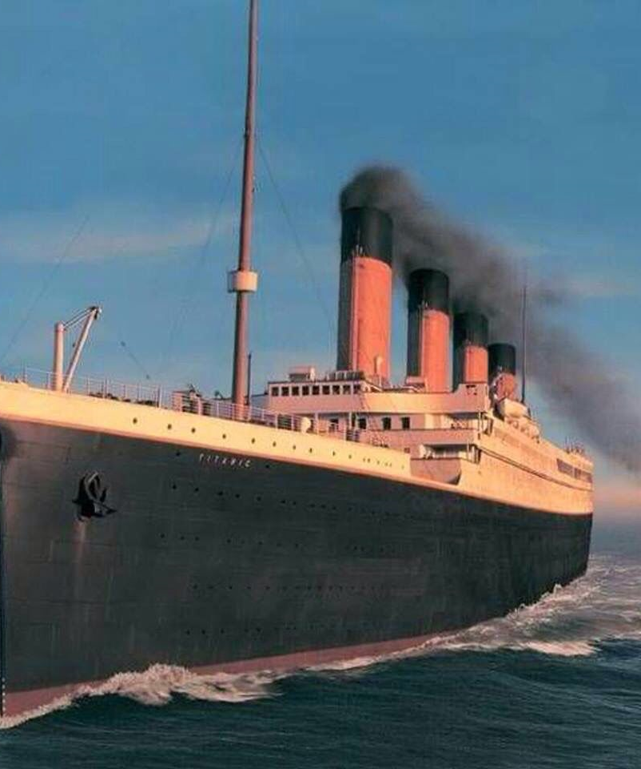
Why Did we choose the Titanic?
The Titanic has always been an extremely captivating and tragic piece of history that still grabs attention today. It was a luxury steamship that was everyone was certain was unsinkable. Unfortunately, it sank on April 15, 1912, after sideswiping an iceberg. The Titanic was transporting men, women, and children ranging in age and different social classes. We were intrigued to learn the differences of survival among such passengers.

Slide 6

Our Journey
We hit a few icebergs along the way, but we made it!
Our journey originally began with a training dataset from Kaggle.com focused on machine learning. Upon reviewing the source, we realized we needed an authentic dataset. We managed to find the raw data from the Titanic and worked our magic.

Slide 7

Methods
Gathered data that is simple yet a complex dataset
Manipulated and wrangled the data
Created new variables
Dropped Nulls and removed unnecessary columns
Recoded the data into numeric form
Used a correlation matrix to summarize the data
Converted the correlation matrix to a heat map
Used Chi Square to reject the Null Hypothesis
Sources used: Python, Jupyter Notebook, Tableau, Visual Studio Code, PowerPoint, Microsoft Word, Slack, Kaggle, GitHub

Slide 8
Exploratory Findings
GitHub Project Link
Jupyter Notebook

Slide 9
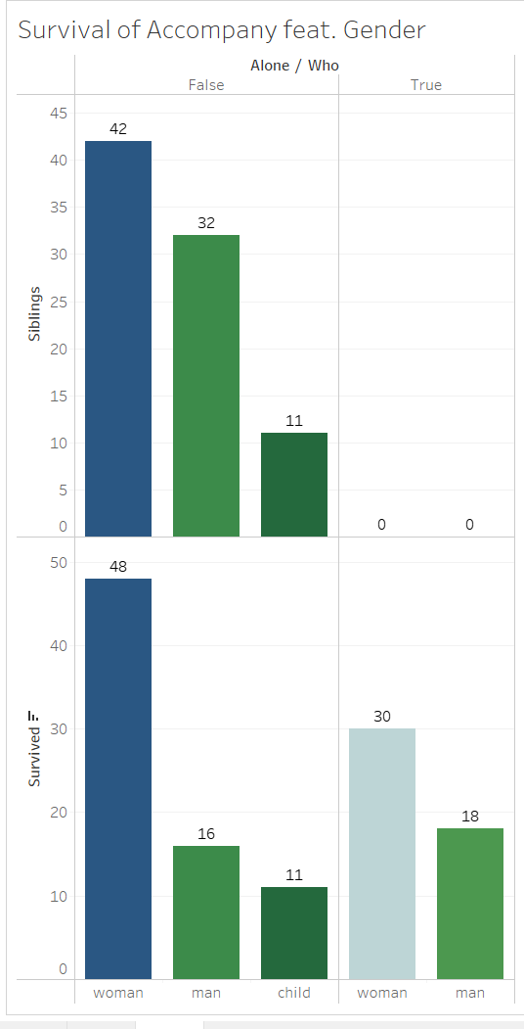
Survival Accompanied by Gender
How many women died alone/together?
Alone: 30
Together: 48
How many men died alone/together?
Alone: 18
Together: 16
How many children died alone/together?
Alone: 0
Together: 11
Who had sibling survivors?
42 women
32 men
11 children

Slide 10
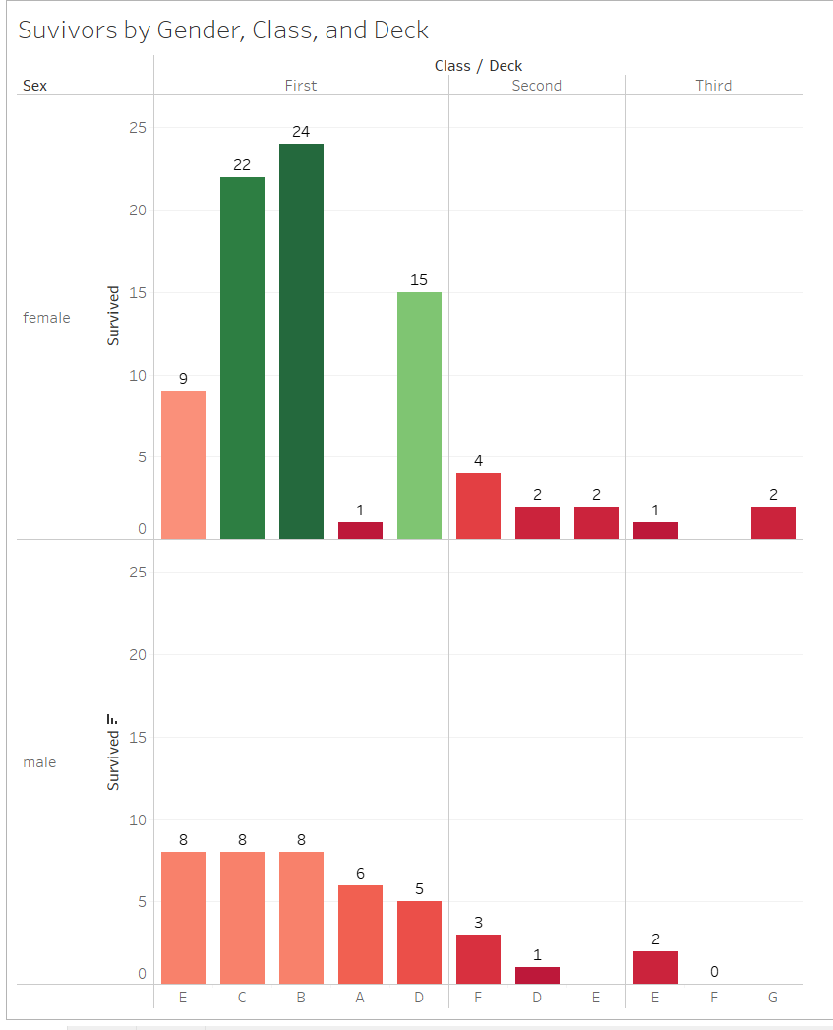
Survivors By Gender, Class, and Deck
How many males survived?
41 males
How many females survived?
82 females
What are the differences between the classes for the survivors?
First Class: 106 individuals
Second Class: 31 individuals
Third Class: 5 individuals
What deck had the most/decrease of survivors?
Deck B

Slide 11
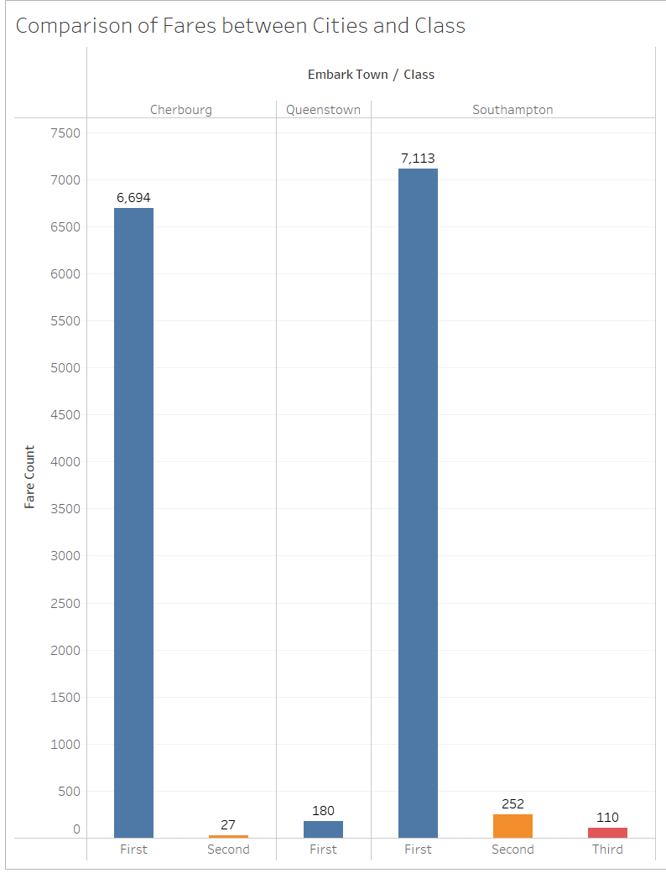
Comparison of Fares
How many fares are from Cherbourg?
First Class: 6,694 individuals
Second Class: 27 individuals
Third Class: 0 individuals
How many fares are from Queenstown?
First Class: 180 individuals
Second Class: 0 individuals
Third Class: 0 individuals
How many fares are from Southampton?
First Class: 7,113 individuals
Second Class: 252 individuals
Third Class: 110 individuals

Slide 12
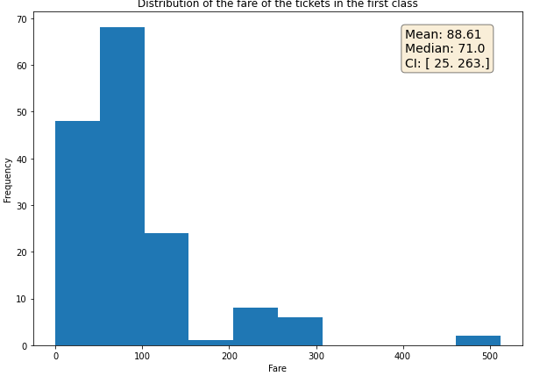
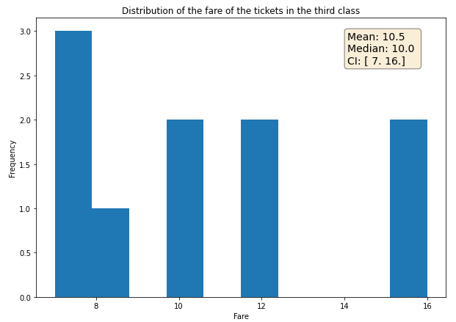
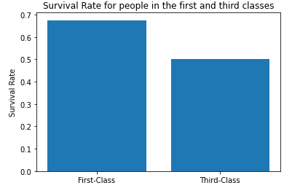
Did the wealthy passengers have a higher survival rate?
THE ANSWER IS YES!
We found this by first determining the distribution of the fare of the first- and third-class passengers, and then checking proportion of those who survived from each group.
The first-class tickets range between 12.72$ and 263$ with an average of 84.15$ while the third-class tickets range between 6.88$ and 56.5$ with an average of 13.68$.

Slide 13
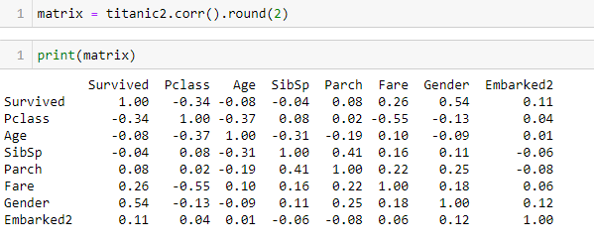
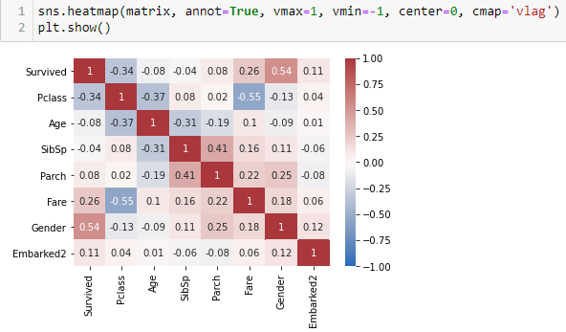
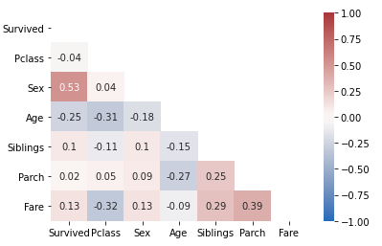
Is there a connection between Age, Gender, and Pclass to survival rates? The answer is YES! According the Matrix, there is a high correlation with Gender, and Pclass. Low correlation with family (Parch/SibSp) and Embarked (location).
Correlation Matrix
Converted matrix to heat map

Slide 14
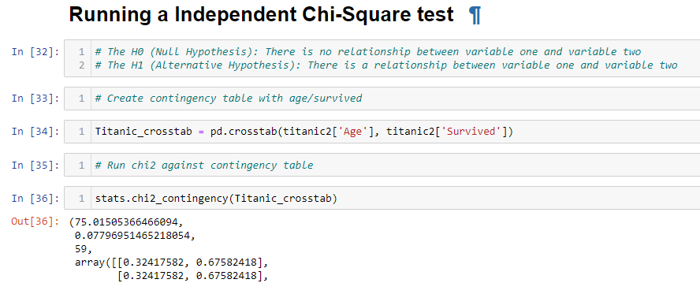
Chi-Square Test
The chi-squared test of independence tests whether two categorical variables (we used Age, Gender, Pclass to Survived) are independent.
We found that Age, Gender, and Pclass all have a significant relationship with survival rates as predicted

Slide 15
Summary
We started this project by doing exploratory data analysis by checking missing data, and learning which features were important. During this process, we used seaborn and matplotlib in Python and Tableau for visualizations to better understand.
During the data processing stage, we:
computed missing values, converted features into numeric values, grouped values into categories, and created new features.
The Correlation Matrix was used to correlating of the survival rate and the remaining variables. The findings showed that there was a high relationship between the Pclass, gender, and age.
After classifying the variables as continuous or categorical, we followed the Statistics flow-chart and proceeded with an Independent Chi-Square.
The Titanic survival outcome was depended upon several predictors, such as sex, age and passenger class. Women were more likely to survive at 93% compared to men who survived at 43%. Passengers from the lower classes had a lower survivor rate.

Slide 16
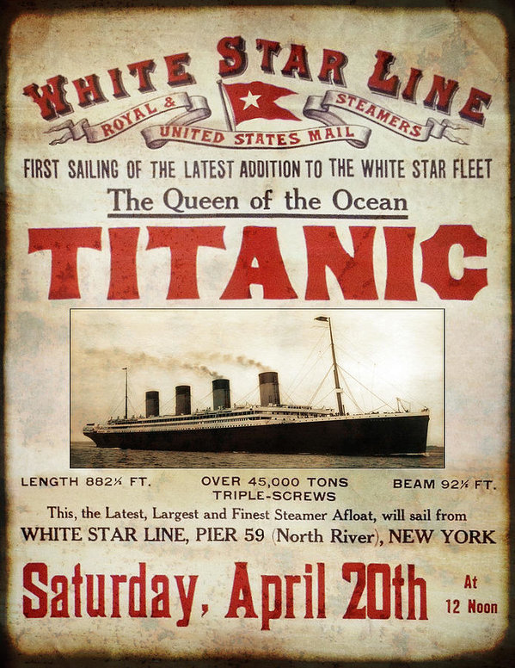
Conclusions
Our findings impact the world by teaching us valuable lessons that are still prevalent today. It’s important to keep in mind future icebergs, so to speak, in our path to reaching our goals and obtaining success. We need to plan accordantly and have back up plans in place just in case.
One of the first findings was the overconfidence by the captain and crew. Everyone was so certain that the ship was unsinkable that they failed to plan out things accordingly and this led to poor judgment and bad decisions.
The bad decisions of the crew members lead to an inadequate number of lifeboats for everyone. The final decision came down to mainly first-class passengers with majority of the passengers being women and children.
In addition to the first finding, every life is valuable despite the differences in age, gender, and social economic status. It was unfortunate that first class was deemed high priority because of their financial status and social class. The history of the Titanic changed the outlook of safety while being at sea. Furthermore, it saves lives and connects centuries of errors.
`

Slide 17

Questions?

